Slide 1

QIKcom-1 re-configurable Transponder module
Michael Segalla and Cole Skinker
Advisor: Bob Bruninga
AIAA YPSE Conference
November 7, 2014

Slide 2
Problem Background
Automatic Packet Reporting System Protocol (APRS) is the primary communications protocol used by several USNA student satellites
With long development time, the response time for short fuse launch opportunities is limited
There is only one APRS amateur satellite in operation currently

Slide 3
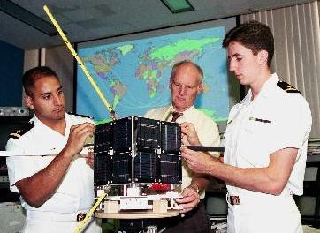
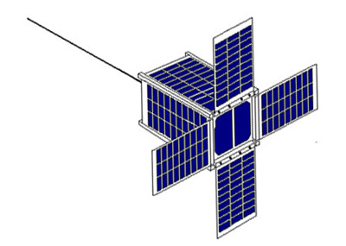
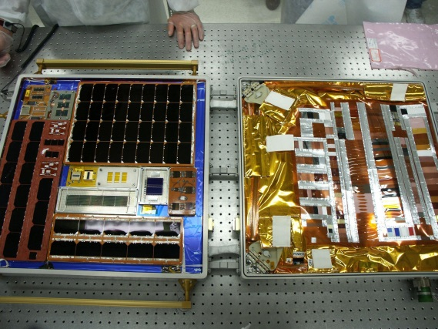
Slow Development Time
PCSAT-1 : comm satellite, 4 years to design and deliver for launch
  Still sem-operational (in good sun)
PSAT: communications CubeSat,
  Time to deliver: ~6 years
  Currently in work – manifest 2015
PCSAT-2: communication payload, 2 years, attached to ISS
  Returned to Earth after 1 year

Slide 4
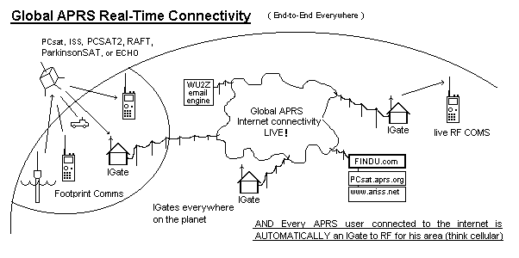
Automatic Packet Reporting System (APRS)
Notes:
Digital communications protocol where amateur users transmit data to passing satellites which relay that information to other users beyond the horizon
First employed in 1984 by cross-country endurance horse race for status updates and location tracking, now primarily used by amateur radio enthusiasts

Slide 5


Host Satellite Opportunity
NovaWurks has offered to fly a USNA student module on a host satellite
  Host satellite provides:
    Power
    Thermal control
    Attitude determination system
    Location for mounting interface

Slide 6
Requirements: Host
Host Requirements
Voltage | 28V
Temperature Range | -20 °C - 60°C
Housing Structure Size | No larger than 4” x 6”
Communications | Reliable dual-antenna deployment system

Slide 7
Requirements: USNA
USNA Requirements
Users ~per minute | 6
Packets ~per pass | 51
Operational Availability | Dependent on host specs
Thermal Control : From Host S/C | Host provides Temp Control within Min / Max Range
Schedule
 | Threshold | Objective
Delivery | 29-Dec | 15-Dec
Lifetime | 5 months | 4.5 months
Reliability confidence | 90 | 90
Notes:
6 Users per minute matches the 18% optimal channel loading for an Aloha Network

Slide 8

QIKcom-1 Objectives
Produce a transponder for Amateur Satellite Service within short-fuse 5 month period
Provide an on-board beacon to actively notify wilderness terrestrial amateur radio users in North America when satellite is available
APRS Integrated Network

Slide 9
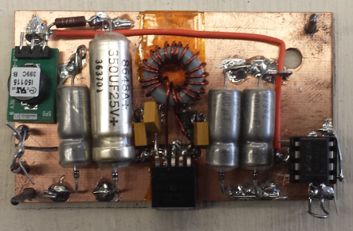
Solution
USNA shall combine following COTS and self-designed components to produce module
  COTS:
    MT-TT4 transponder from Byonics.com:
    Micro-Amp 3 power amplifier: necessary to boost antenna power
    Mictro-Trak 8000 FA communications beacon: operates on terrestrial frequency, notifies users of satellite overhead
Designed components:
    Antenna deployment board
    EPS regulating board
EPS Board

Slide 10
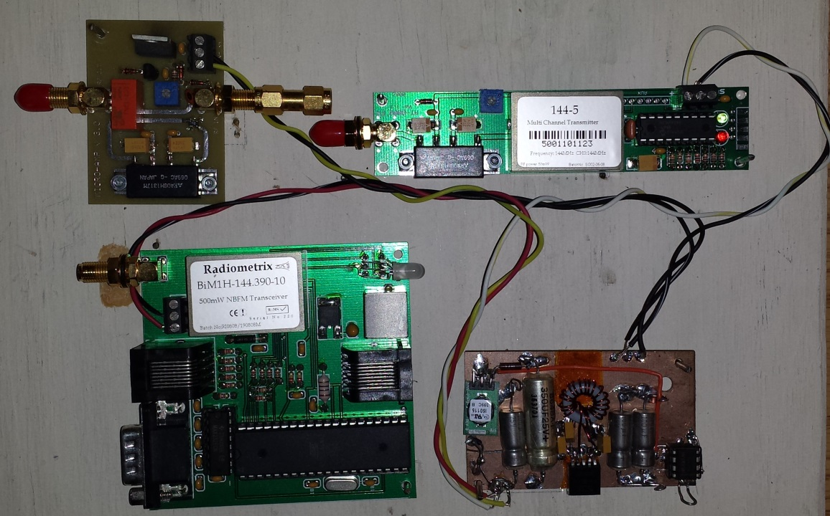

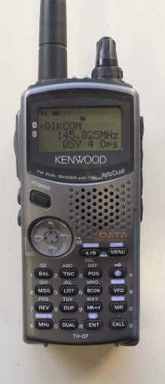
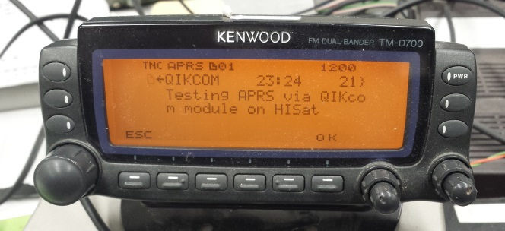

Concept of Operations
Beacon notifies users when QIKcom-1 is overhead on
terrestrial 144.39 frequency.
Switch from 144.390 MHz to 145.825 MHz and operate for next 8 minutes of pass
Users tune to space frequency
QIKcom Transponder module

Slide 11

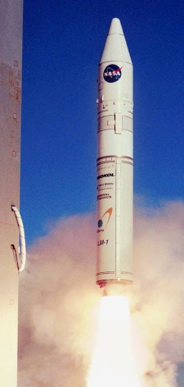
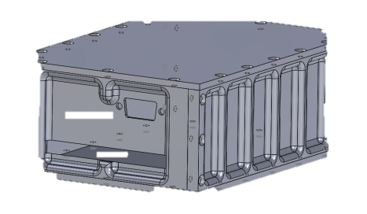
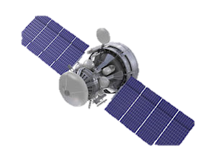
Satellite positioned in launch vehicle
Launch vehicle proposed take-off: March 2015
Transponder module placed inside interface structure
Module placed on NovaWurks SIMPL Satellite

Slide 12



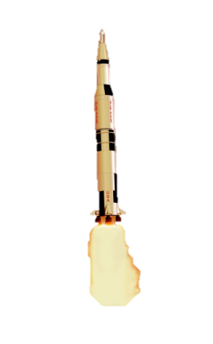


NuvaWorks SIMPL Satellite deployed from ISS into 1-month mission orbit
Rocket Payload rendezvous with ISS
Launch 9 Dec 2015

Slide 13
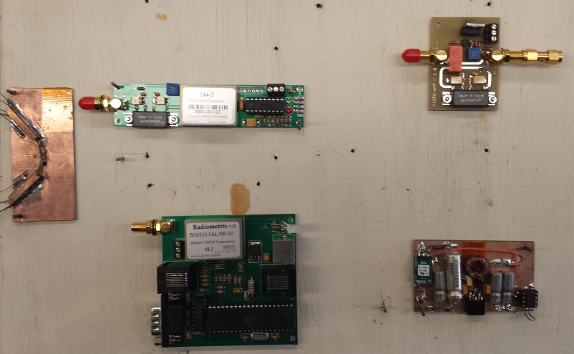
System Overview
Electrical Power System: 28 Volts supplied by host spacecraft
Attitude Control: Host satellite orients satellite and reports GPS position to QIKCOM-1 to determin when to beacon on 144.39 over USA
Thermal Control: -20 °C ↔ 60 °C
Engineering model Components assembled together on working board

Slide 14
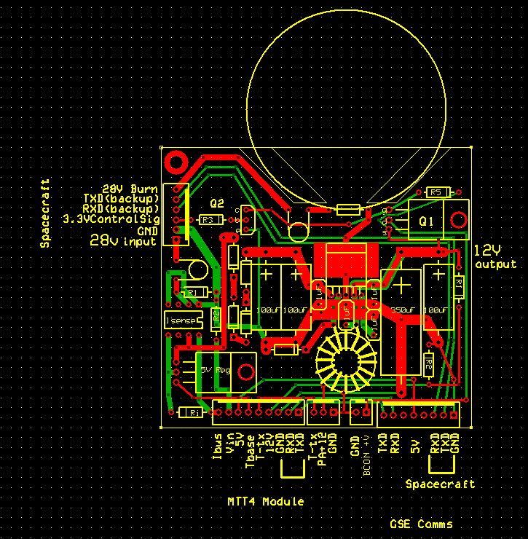
Electrical Power System
Power Budget
Power Budget
Load | Operating Voltage | I _{pk} (mA) | Duty Cycle | I _{avg} (mA) | 28V I_{pk} (mA) | 28V I_{ave} (mA)
Beacon (Standby) | 12 | 15 | 98.3% | 14.75 | 7.14 | 7.02
Beacon (TX) | 12 | 1000 | 1.70% | 17 | 476.2 | 8.1
MTT4 (TX-users) | 5 | 280 | 1.7% | 4.8 | 55.6 | 0.95
MTT4 (TX-Telemetry) | 5 | 280 | 4% | 11.2 | 55.6 | 2.2
MTT4 (RX) | 5 | 45 | 100% | 45 | 8.93 | 8.93
Power Amp (TX) | 12 | 1000 | 10% | 100 | 476.2 | 47.62
Total |  |  |  |  | 1079.6 | 74.8
PCB Board Design
28 V - Peak Power (W) | 30
28 V – Average Power (W) | 2.1
Power provided by host bus. P_{avg} of 2W consistent with 1U CubeSats, however all is dedicated to the user data relay mission rather than other subsystems allowing 4 Watt downlink power

Slide 15
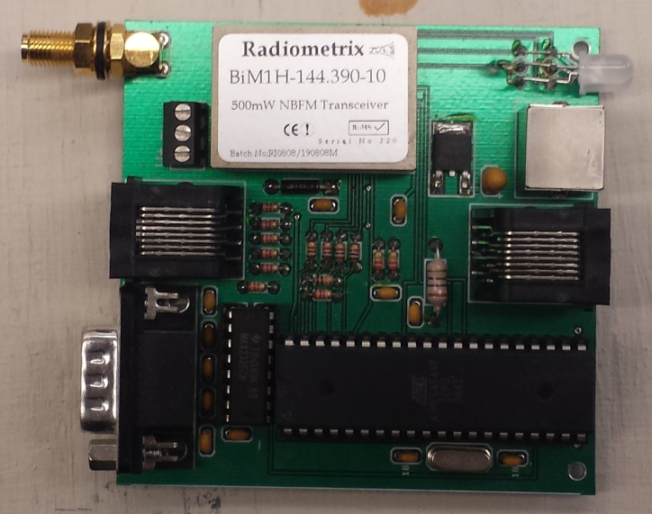
Telemetry and Link Budget
Frequencies | 145.825 MHz - 4 Watt - AX.25 Telemetry downlink
ITU Emission Designator | 16K0F1D, FM, 1200-9600 baud AX.25 data rate
Antenna | Cross polarized 1/4 wave whips
Power transmitted | 6 dBW
Transmitter Gain | 0 dB
Receiver Gain | 15 dB
Space Loss at max range of 3000 km | -145.5 dB
Computed Receiver Power | -127.5 dBW
RX threshold | -146 dBW
Margin at horizon for Oscar class sation | 18.5 dB
Margin for hand-held omni-antenna | 3.5 dB
TT&C and Downlink
Operations | United States Naval Academy
Mission Downlinks | Amateur Radio Operators
3.5 dB sufficient margin to a walkie-talkie for any amateur operator to communicate with QIKcom-1 if within view

Slide 16
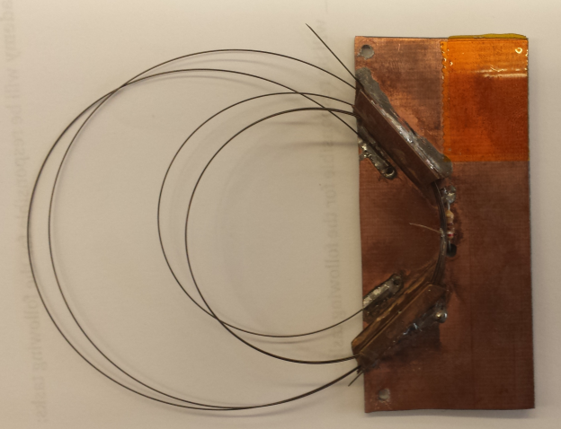
Antenna Deployment System
Orthogonal dual 2m whip antennas
Lone burn resistor tied with fishing line
Reliability demonstrated: 50 of 50 successful tests for confidence
Stacked housing
Antenna deployment system

Slide 17
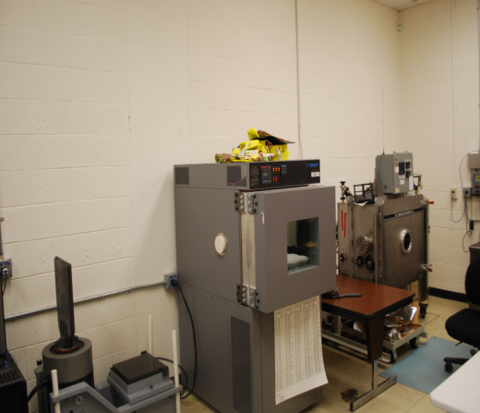
Thermal and EPS Sensors
5 telemetry Sensors:
2 Thermistors located on MTT4 and power amplifier, monitor safe operating temperatures
1 Voltage and 1 current sensors to monitor input from host bus
12V sensor to monitor proper regulation of power to power amplifier and beacon
GPS and Host power status included in a telemetry beacon
Tests completed to date:
  Thermistor Calibration
Recent test:
  Thermistor Calibration

Slide 18
Conclusions

Slide 19
Summary
Host Requirements |  | Parameter met?
Voltage | 28V | Yes
Temperature Range | -20 °C - 60°C | Requires Testing
Housing Structure Size | No larger than 4” x 6” | Yes
Communications | Reliable dual-antenna deployment system | Requires Testing
COTS and USNA components combined in rapid manner
  Turnaround of 5 months achieved
    Reduced lead time by 1/4 of previous comparable USNA satellite (PCSAT2)
  Satellite enthusiasts notified via alert beacon when satellite is overhead
    Link budget indicates beacon sufficient

Slide 20
Future Schedule
Integrate PCB chip
Test (Vibration / Thermal)
Launch (March)
Delivery (Dec. 29th)

Slide 21
Acknowledgements
CDR Robert Bruninga, USN (ret.)
Assistant Professor Jin Kang

Slide 22
Thank you for your time
Questions?

